Slide 1
Capstone Project
PREDICTING THE SEVERITY OF CAR ACCIDENTS

Slide 2
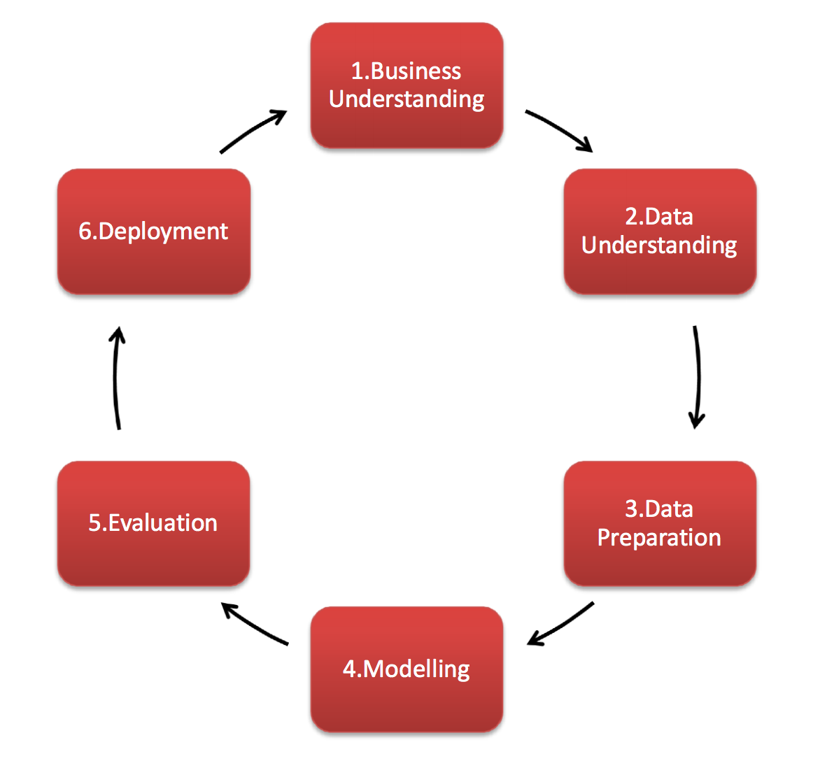
Problem Statement
The project aims to predict the severity of car accidents. The methodology implemented throughout the project is called as CRISP

Slide 3
Feature Selection
Feature selection/engineering is the process of using domain knowledge to extract features from raw data via data mining techniques
The features selected are shown in the table below
CATEGORICAL VARIABLES | NUMERICAL VARIABLES
SEVERITYDESC | PERSONCOUNT
ADDRTYPE | PEDCOUNT
COLLISIONTYPE | PEDCYLCOUNT
JUNCTIONTYPE | VEHCOUNT
WEATHER | SEVERITYCODE
ROADCOND
LIGHTCOND

Slide 4
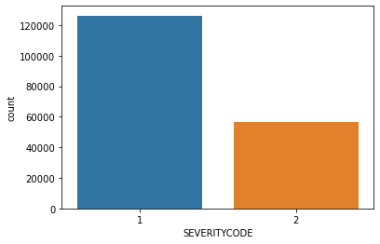
Exploratory Data Analysis
Majority of car accidents belongs to SEVERITYCODE of type 1

Slide 5
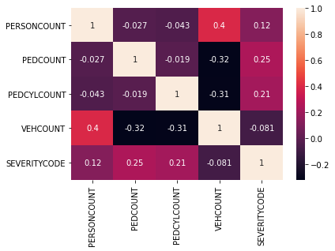
Exploratory Data Analysis
Heat-map showing the correlation between different metrics

Slide 6
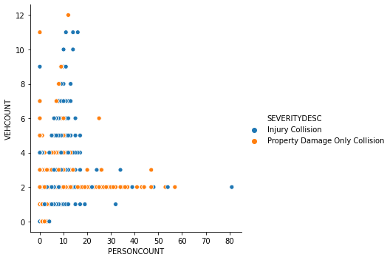
Exploratory Data Analysis

Slide 7
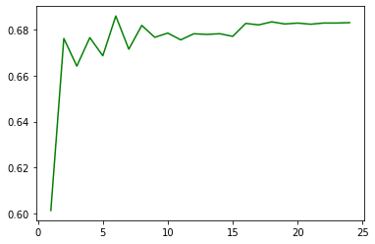
Predictive Modeling - KNN
For K = 6 has the highest Accuracy of 0.68

Slide 8
Results of Decision Tree and Logistic Regression Models
MODEL | ACCURACY
DECISION TREE | 0.69
MODEL | Jaccard Score | F1 Score | LogLoss
Logistic Regression | 0.684 | 0.811 | 0.59

